Slide 1
FOOD &
NUTRACEUTICAL UNIT
Akola Chemicals (India ) Ltd was incorporated in 1981, in Akola. The company has two independent manufacturing facilities located at Akola, Maharashtra, India.
FOOD & PHARMACEUTICAL Unit: Originally a WHO-GMP unit for Formulations of Ointments, ORS powder. Now reset as a FSSAI approved unit for Proteins products used in the Pharmaceutical, Cosmetics and Food Industries.
AGRO and Chemical Unit, for manufacture of Plant Nutrition and Animal nutrition Products

Slide 2
Food & Nutraceutical Unit
FSSAI approved Food and Nutraceutical unit has facilities for the Manufacture of Hydrolyzed proteins and spray drying the products for Food and Nutraceutical industry.
Special proteins for cosmetics
Gelatin based proteins for animal and plant nutrition.
Packing section (formerly a WHO-GMP Unit for manufacture of ORS salts and ointments)

Slide 3
Nutra & Cosmetic Unit

Slide 4
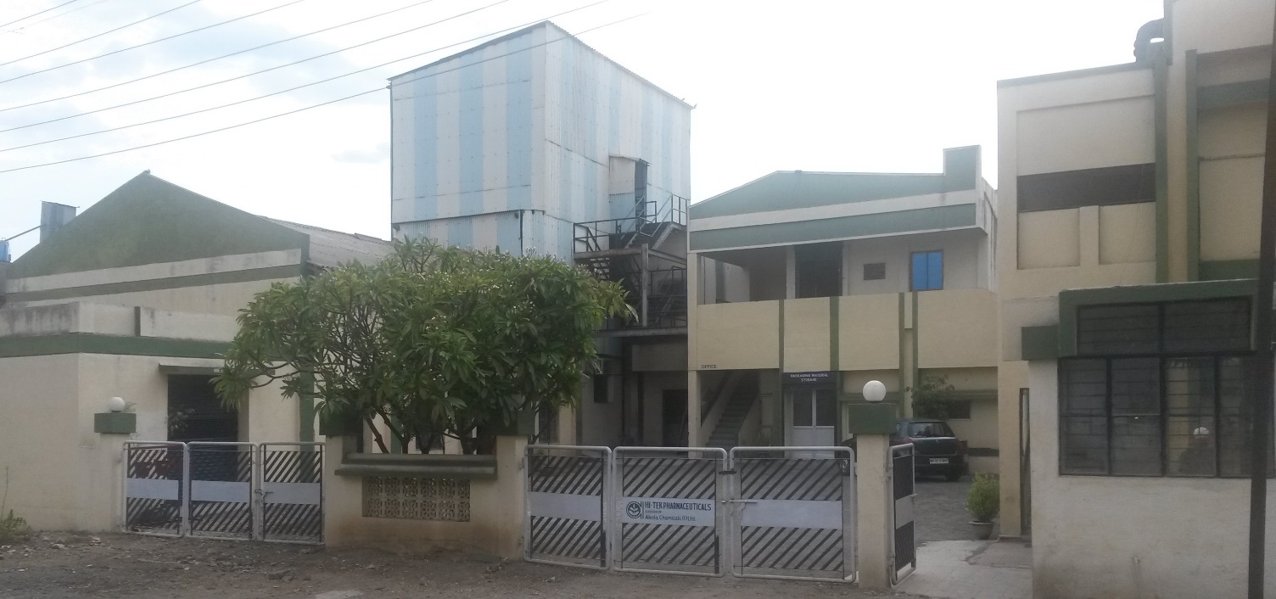
Hydrolysed Protein Plant

Slide 5
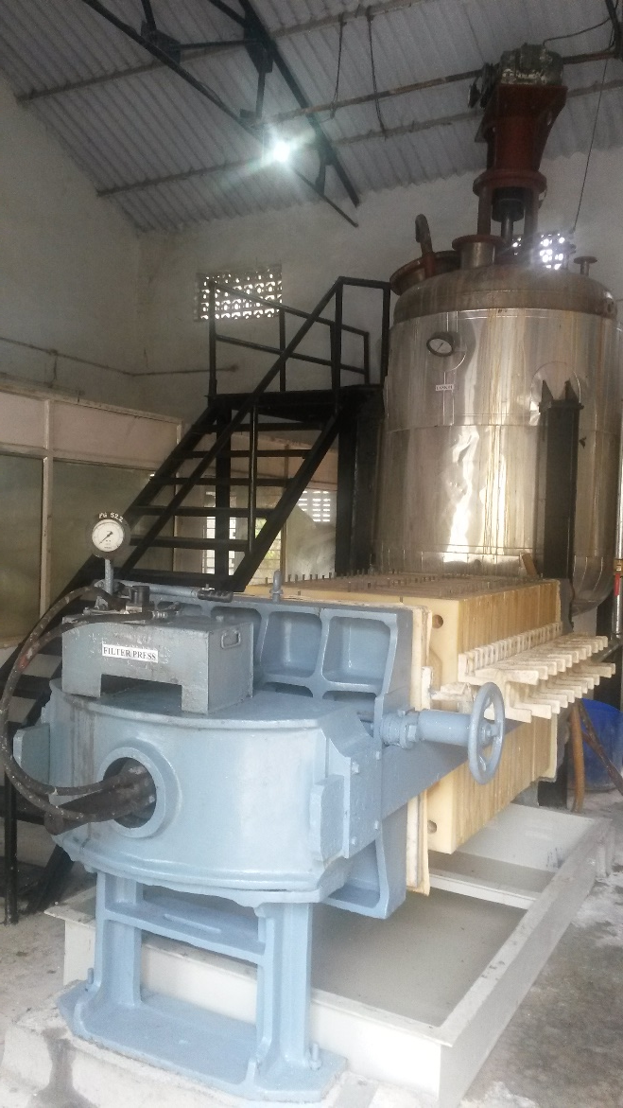
Protein Hydrolyzation Plant

Slide 6
SPRAY DRIER
For Drying
ATOMISER
AND HOT AIR ENTRY

Slide 7
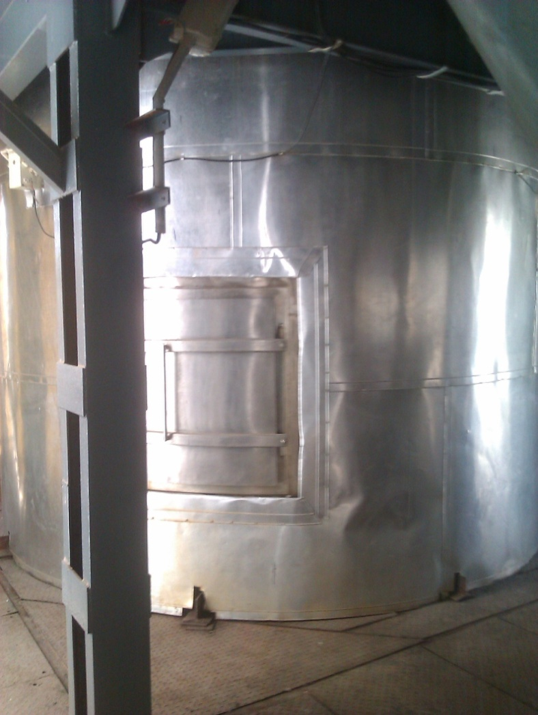
SPRAY DRIER : Main Tower

Slide 8
Spray Dryer
CYCLONE
SEPARATOR
to Maintain
Zero emission

Slide 9
Spray Dryer
Finished Product Packing in a
Clean air
chamber

Slide 10
DCS Control of Sprayer drier

Slide 11
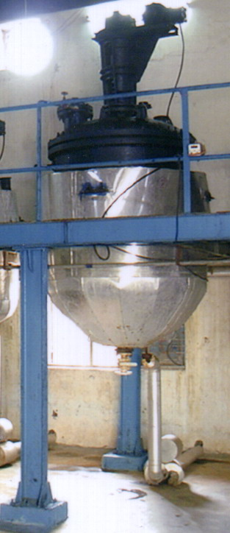
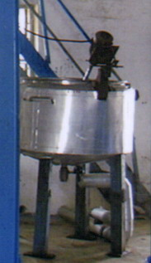
The Special Proteins Section.
Has a capacity to manufacture 300 MT of Protein Hydrolysate per Annum

Slide 12
The Cosmetic Section
Manufacturing & packing of Protein based Cosmetic Intermediates.
Production capacity of Liq. Products is 12,000 Liters per month.

Slide 13
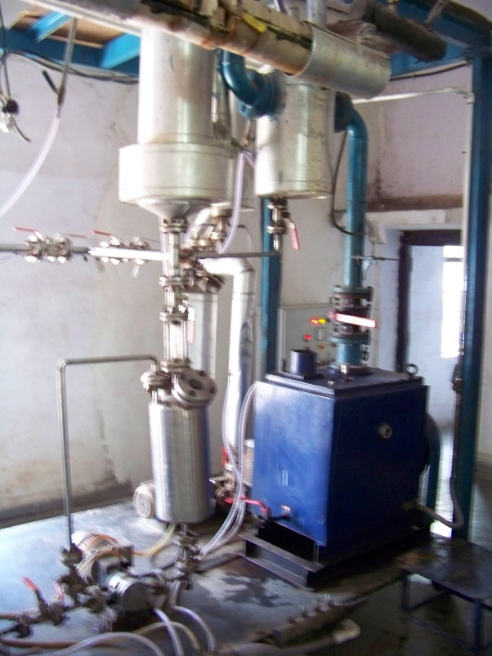
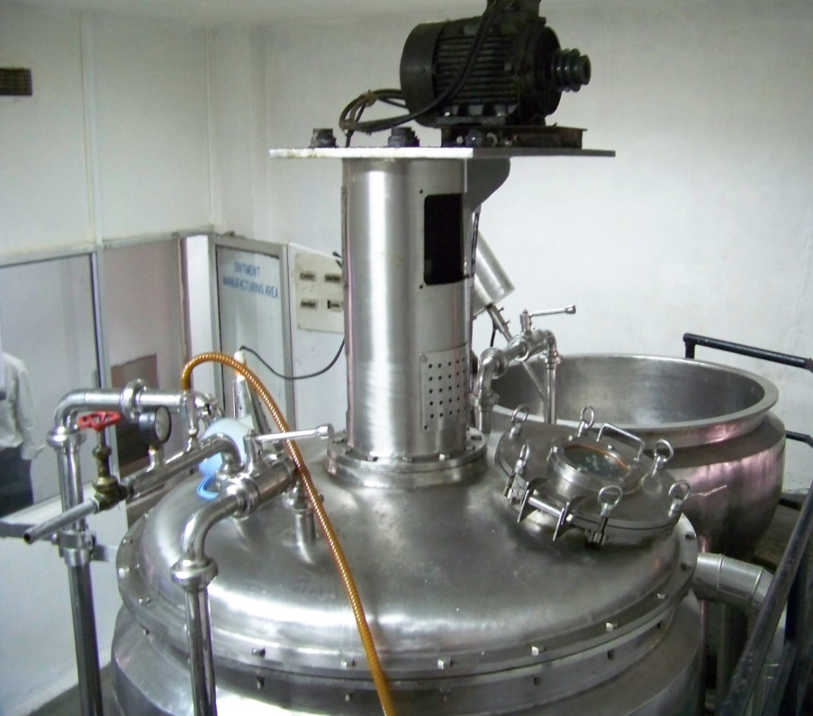
Refining & Deodorizing Units

Slide 14
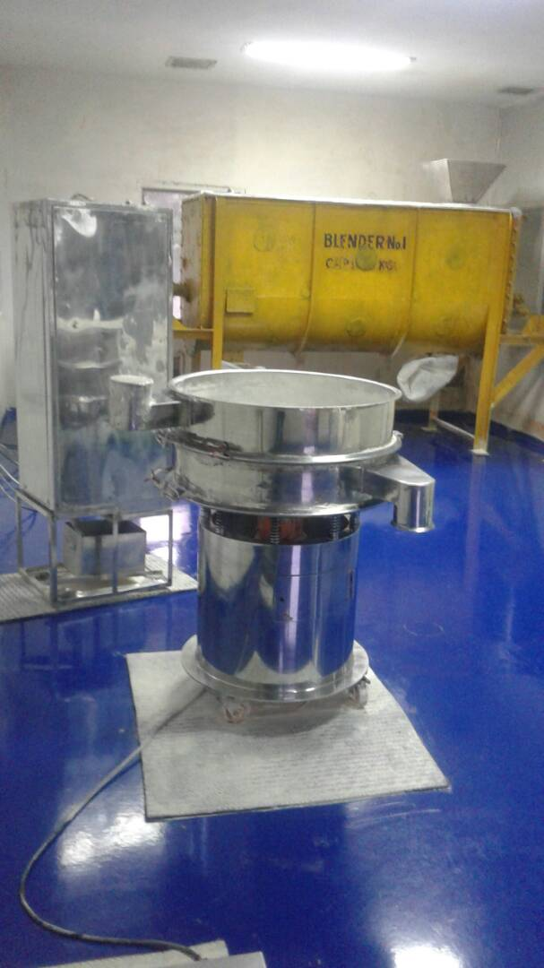
Food Blending & Packing Section

Slide 15
Powder - sachet Section
Volumetric cup filling
Electronic Photocell Registration system
Electronic Batch Coding Unit
Automatic Atmosphere and Temperature Controls
Machines are as per GMP Model

Slide 16
Nutrient Formulation Section
Can blend and make a variety of food supplements

Slide 17
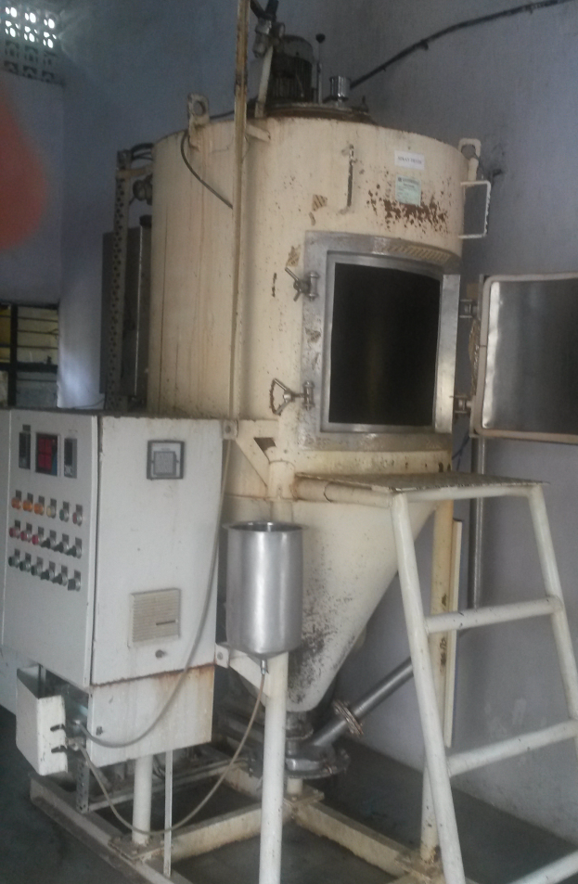
Pilot Plant for developing new products
Spray Drier with a capacity of 5 Kg per hour, evaporation capacity for product development.

Slide 18
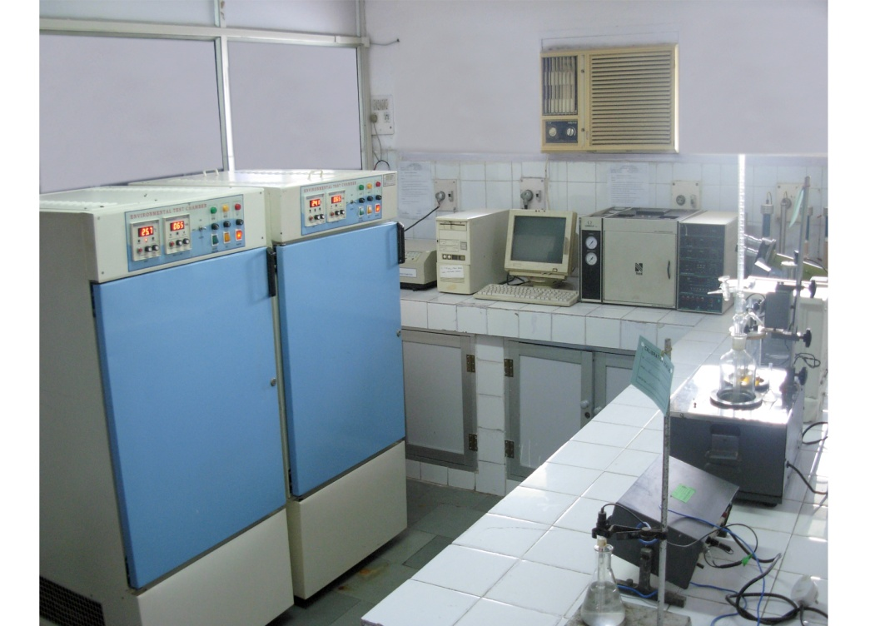
The Quality Control & R&D Section
Analysis of Raw material, PM and others
In-process checks & Finished Goods.
New product development.

